Slide 1
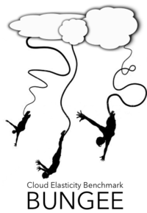
Extending BUNGEE Elasticity Benchmark for Multi-Tier Cloud Applications
- Talk -
André Bauer

Slide 2
Motivation
In academia, many auto-scalers exist
One dimension / single tier
Multi-tier
To guarantee a reliable service, most applications run with a fixed amount of resources
Unnecessary cost if the system is not fully utilized
Bad performance if unexpected peaks appear
How can we increase trust in auto-scalers?
→ Bungee allows to judge auto-scalers based on elasticity
Motivation Approach Evaluation Conclusion

Slide 3
Elasticity Metrics
“Elasticity is the degree to which a system is able to adapt to workload changes by provisioning and deprovisioning resources in an autonomic manner, such that at each point in time the available resources match the current demand as closely as possible.“ https://en.wikipedia.org/wiki/Elasticity_(cloud_computing)
Elasticity metrics
Accuracy: average proportion of resources that the system has over-/under-provisioned
Time Share: average time in which the system is an over-/under-provisioned state
Motivation Approach Evaluation Conclusion

Slide 4
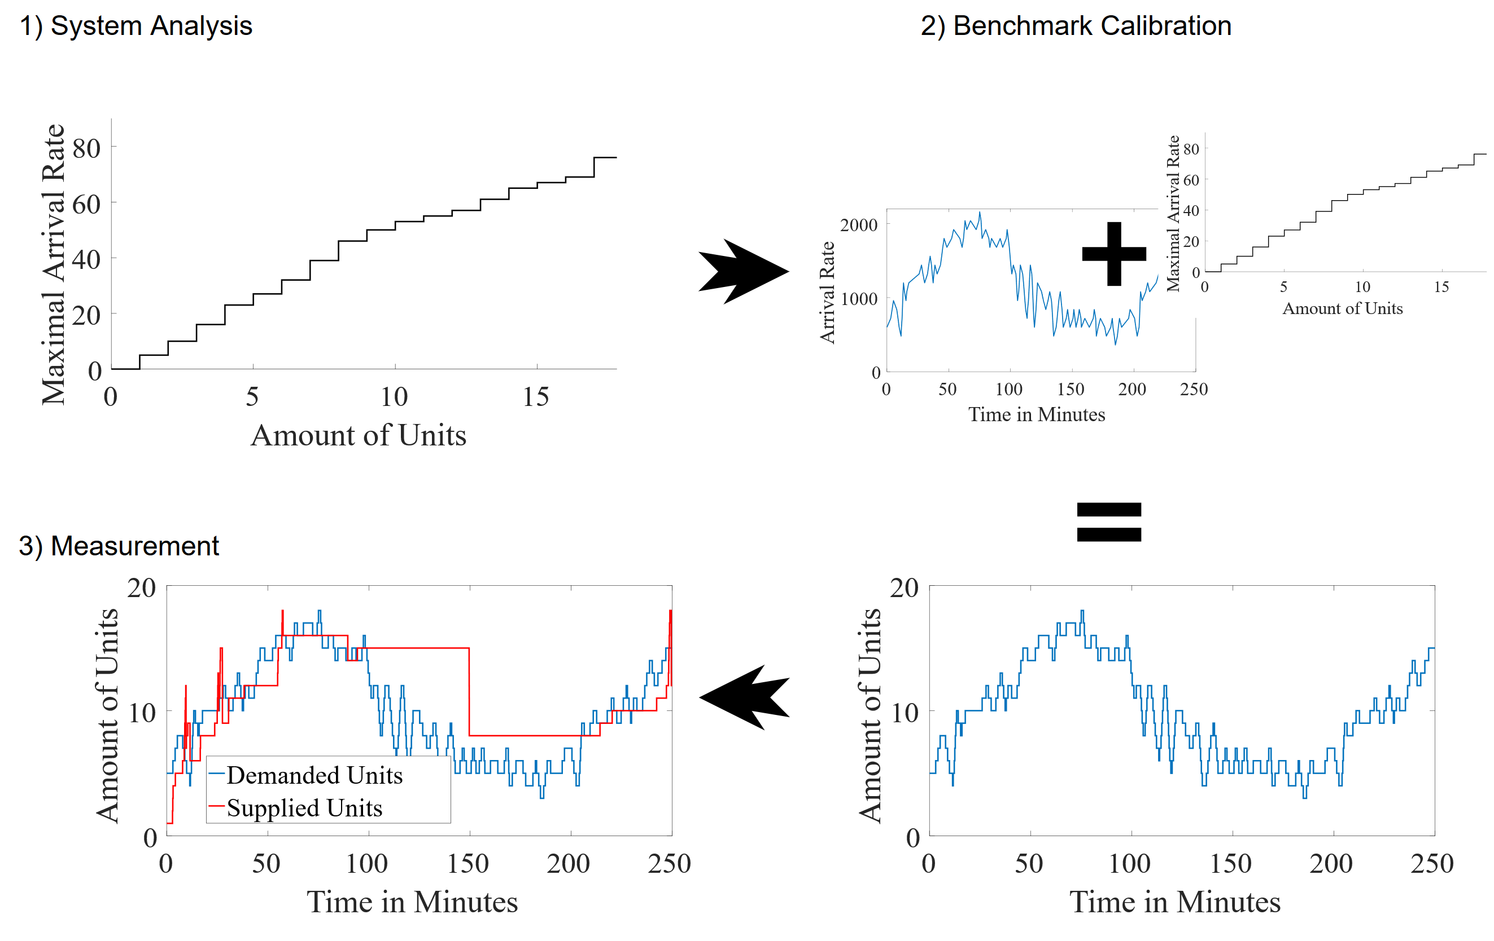
Bungee Experiment Controller
Motivation Approach Evaluation Conclusion

Slide 5
Problem & Idea
Current Bungee supports only resource scaling of single tier applications
Scaling dimension: up or down
Number of possible configurations with $n$ instances: $n$
In practice, most web-applications are built as multi-tier
Scaling dimensions: up or down for each tier
Number of possible configurations with $k$ tiers and each $n$ instances:${ n}^{k}$
Finding pareto optimal configurations
Huge search space
Each experimental search takes several minutes
</>
…
Motivation Approach Evaluation Conclusion

Slide 6
Approach
Config
Number
Load
Config
Number
Load
(1,1,1)
1
7
(1,1,1)
1
7
(1,2,1), (1,1,2)
2
19
(1,2,1)
2
19
Config
Load
(1,1,3)
3
31
(1,1,2)
2
19
(1,1,1)
7
(2,1,3)
4
41
(1,1,3)
3
31
(2,1,1)
7
(2,1,3)
4
41
(1,2,1)
19
(1,1,2)
19
(1,1,3)
31
(2,1,3)
41
Conditions for pareto optimal solution
No smaller configuration can handle same load
No equal configuration can handle a higher load
Derive mapping file
Remove not optimal configurations
Map configuration to number
Summarize configurations with same load
Adapted Hill-Climber called Multi-hill-climber
Allows #tiers sidesteps
Best neighbours are pareto optimal
Config
Load
(1,1,1)
7
(1,2,1)
19
(1,1,2)
19
(1,1,3)
31
(2,1,3)
41
Motivation Approach Evaluation Conclusion

Slide 7
Evaluation System Analysis
Multi-hill-climber (MHC) vs. Strength Pareto Evolutionary Algorithm 2 (SPEA2)
Simulated application
3 Tiers
Up to 10 VMs each
1000 possible configurations
Real web application (CoCoNut)
Web, business, and data tier
Up to 4 VMs each
64 possible configurations
Algorithm | True Positiv [%] | False Positiv [%] | #Searches
MHC | 100 | 0 | 60
SPEA2 | 91.6 | 7 | 131
Algorithm | True Positiv [%] | False Positiv [%] | #Searches
MHC | 100 | 0 | 29
SPEA2 | 76 | 2 | 33
Motivation Approach Evaluation Conclusion

Slide 8
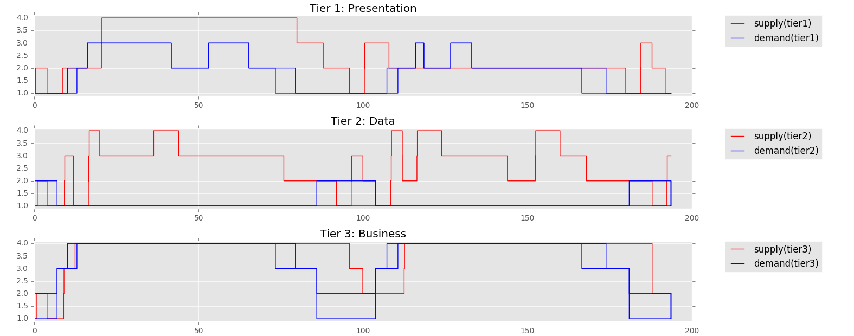
Measurement
Motivation Approach Evaluation Conclusion

Slide 9
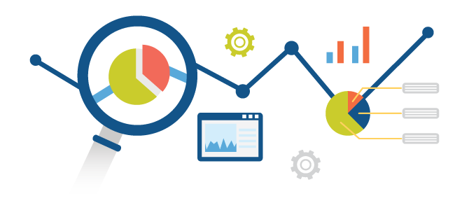
Open Challenges
Further metrics besides single tier?
Sum of all tiers?
Distance/Deviation?
Manhattan?
Euclid?
…
How to quantify not visited neighbours?
E.g., (1,2,2) optimal, which one is worse?
(2,1,2)
(1,1,3)
(2,2,2)
(1,2,2)
? (2,1,2)
Motivation Approach Evaluation Conclusion

Slide 10
In a Nutshell…
How can we increase trust in auto-scaler?
Originally Bungee was only applicable for single tier
System analysis was extended with own Multi-hill-climber
Evaluation/Metrics have to be adapted
Multi-tier search has to face Pareto problem
$k$ Tiers with $n$ VMs each → ${ n}^{k}$ configurations
Each experimental search takes several minutes
Open challenges for quantifying the not-optimal configurations
Motivation Approach Evaluation Conclusion

Slide 11
Thank you for your attention
Slides are available at https://descartes.tools/

Slide 12
Elasticity Metrics
Provision accuracy
Wrong provision time-share

Slide 13
Multi-Hill-Climber

