Slide 1


TeaStore
A Micro-Service Application for Benchmarking, Modeling and Resource Management Research
Jóakim von Kistowski, Simon Eismann, André Bauer, Norbert Schmitt, Johannes Grohmann, Samuel Kounev
February 21, 2019
Notes:
Tailoring Performance Prediction Processes to Situational Requirements

Slide 2
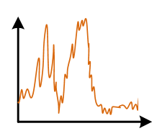
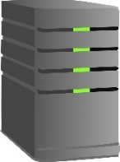

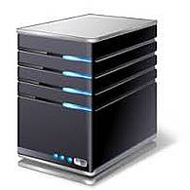
Example Research Scenario
?
?
A, B, C?
Service A
Service B
Service C
?
Many solutions for these questions have been proposed, however…
Introduction TeaStore Use-Cases Conclusion
Notes:
Descriptive or predictive performance models

Slide 3
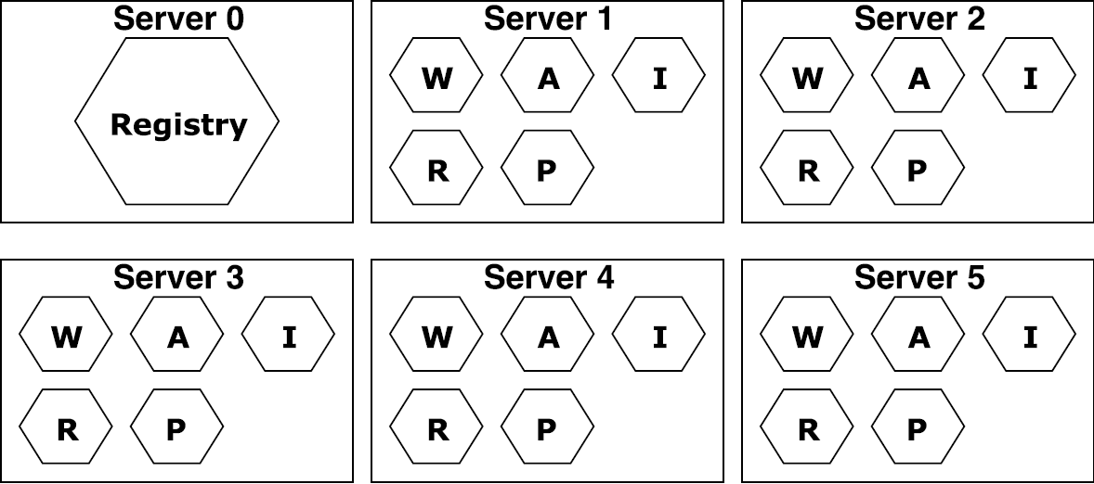
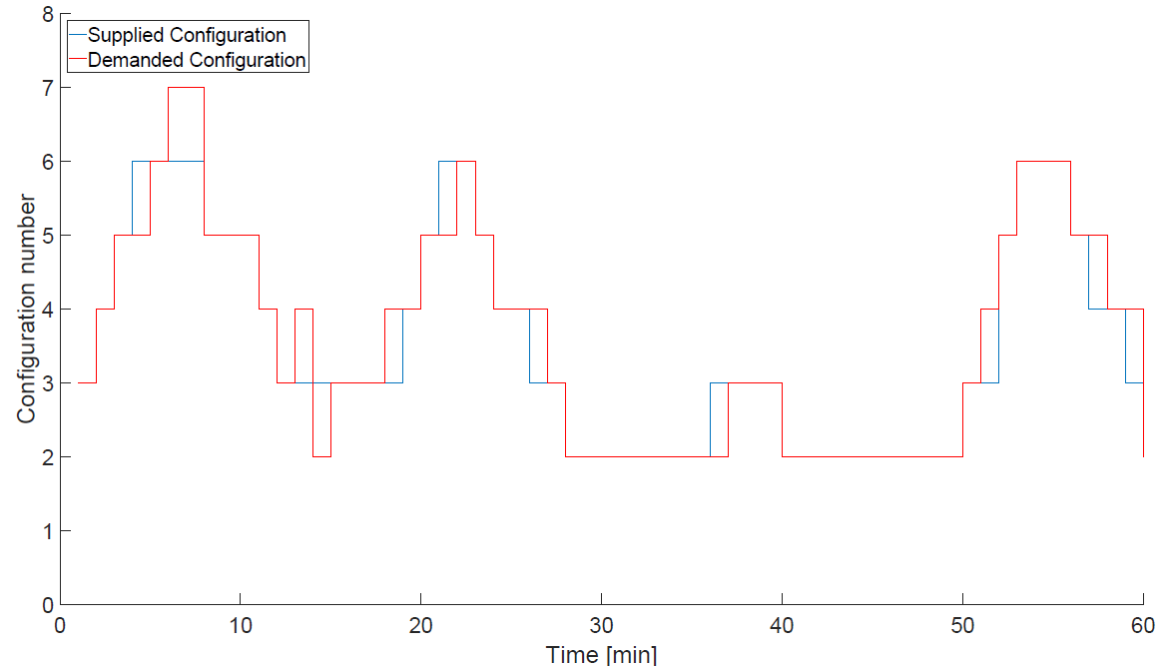

Challenge
How to evaluate
Placement algorithms
Auto-scalers
Modeling approaches
Model extractors
Require realistic reference and test applications
Reference applications help to
Evaluate model
(extractor) accuracy
Measure auto-scaler
elasticity
Measure placement
power consumption
and performance
Introduction TeaStore Use-Cases Conclusion

Slide 4


Requirements for a Test Application
Scalable
Allows for changes at run-time
Reproducible performance results
Diverse performance behavior
Dependable and stable
Online monitoring
Load profiles
Simple setup
Modern, representative technology stack
Introduction TeaStore Use-Cases Conclusion

Slide 5


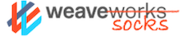
Existing Test Applications
RUBiS [1]
  eBay-like bidding platform
  Created 2002
  Single service
SPECjEnterprise 2010 [2]
  SPEC Java Enterprise benchmark
  Three tier architecture
  No run-time scaling
  Database is primary bottleneck
Sock Shop [3]
  Microservice network management demo application
  Created 2016
  Low load on non-network resources
Dell DVDStore, ACME Air, Spring Cloud Demo, and more in our MASCOTS paper [4]
Introduction TeaStore Use-Cases Conclusion

Slide 6



The TeaStore
Micro-service test application
Five services + registry
Netflix “Ribbon” client-side load balancer
Kieker APM [5]
Documented deployment options:
  Manual
  Docker images
  Kubernetes
WebUI
Reg-istry
Auth
Image
Recom-mender
Persis-tence
Introduction TeaStore Use-Cases Conclusion

Slide 7




Services I
Registry
Simplified Netflix Eureka
Service location repository
Heartbeat
RegistryClient
Dependency for every service
Netflix “Ribbon”
Load balances for each client
WebUI
Servlets/Bootstrap
Integrates other services into UI
CPU + Memory + Network I/O
Authentication
Session + PW validation
SHA512 + BCrypt
CPU
Introduction TeaStore Use-Cases Conclusion

Slide 8



Services II
PersistenceProvider
Encapsulates DB
Caching + cache coherence
Memory
ImageProvider
Loads images from HDD
6 cache implementations
Memory + Disk I/O
Recommender
Recommends pro-
ducts based on history
4 different algorithms
Memory or CPU
TraceRepository
AMQP Server
Collects traces from all services
Introduction TeaStore Use-Cases Conclusion
Notes:
Database size

Slide 9
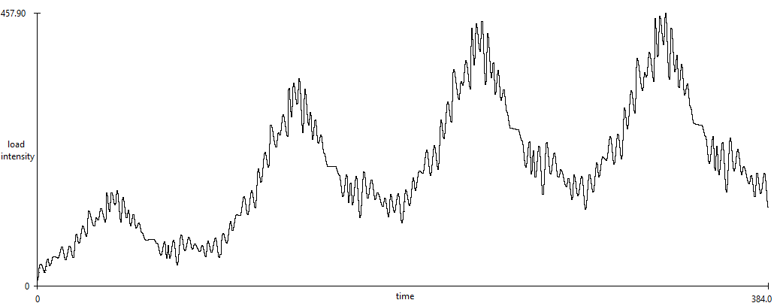
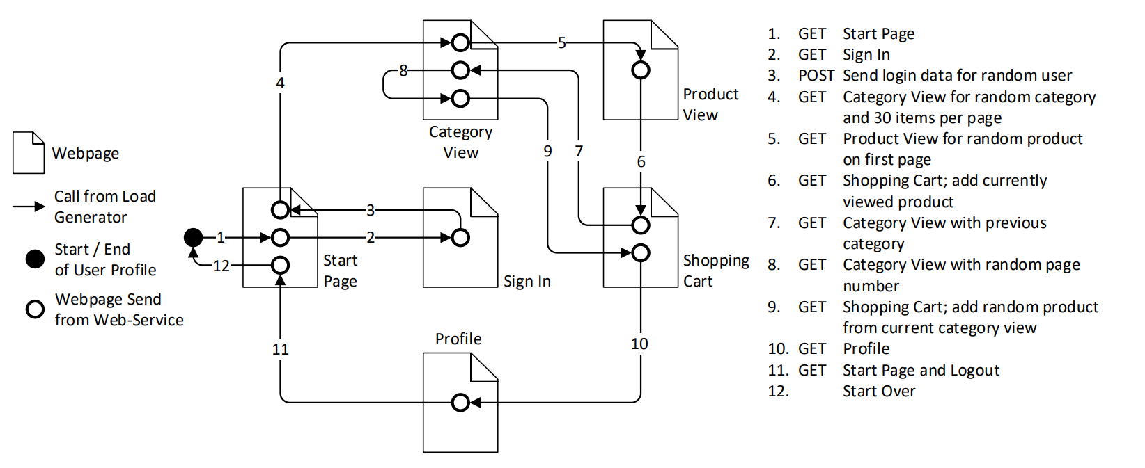
Load and Usage Profiles (1/2)
HTTP load generator [5]
Supports varying load intensity profiles
  Can be created manually
  Or using LIMBO [6]
Scriptable user behavior
  Uses LUA scripting language
  “Browse” and “Buy” profiles on GitHub
Arrival rate
time
https://github.com/joakimkistowski/HTTP-Load-Generator
Introduction TeaStore Use-Cases Conclusion

Slide 10
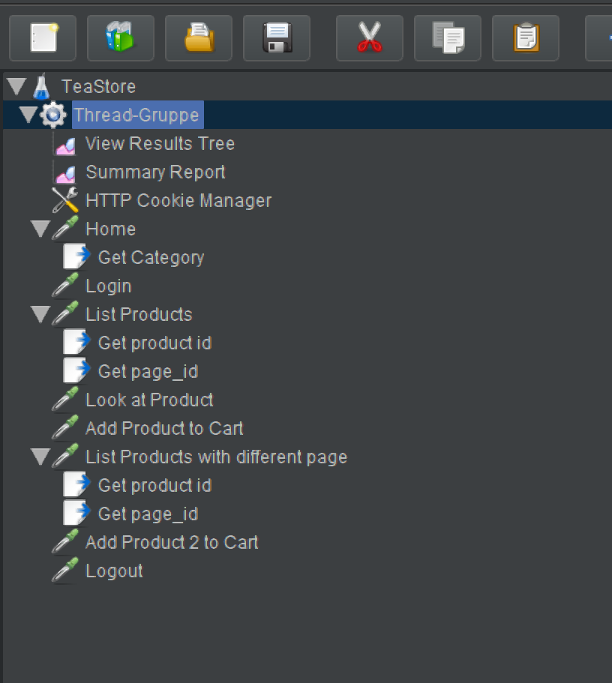
Load and Usage Profiles (2/2)
JMeter
Commonly used load generator
Browse profile for JMeter
Identical to HTTP Load Generator profile
Introduction TeaStore Use-Cases Conclusion

Slide 11
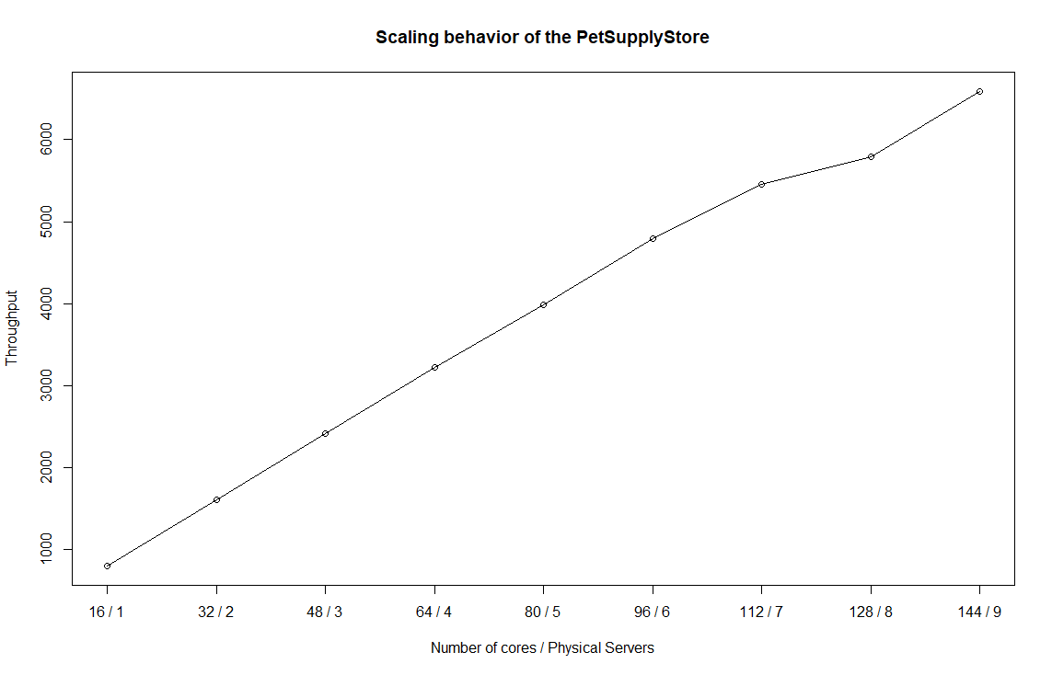
Evaluation Teaser: Does it scale?
Scales linearly
Stresses 144 cores on 9 physical hosts
HTTP Load Generator handles > 6000 requests per second
Introduction TeaStore Use-Cases Conclusion

Slide 12
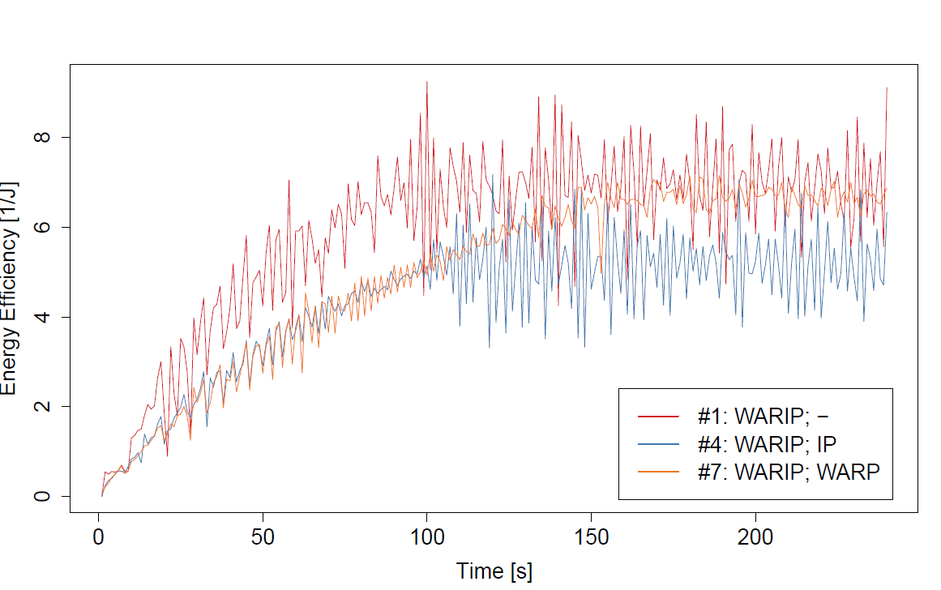
Evaluation
Three Use-Cases
Auto-Scaling
Performance modeling
Energy-efficiency of placements
Goal: Demonstrate TeaStore’s use in these contexts
Introduction TeaStore Use-Cases Conclusion

Slide 13

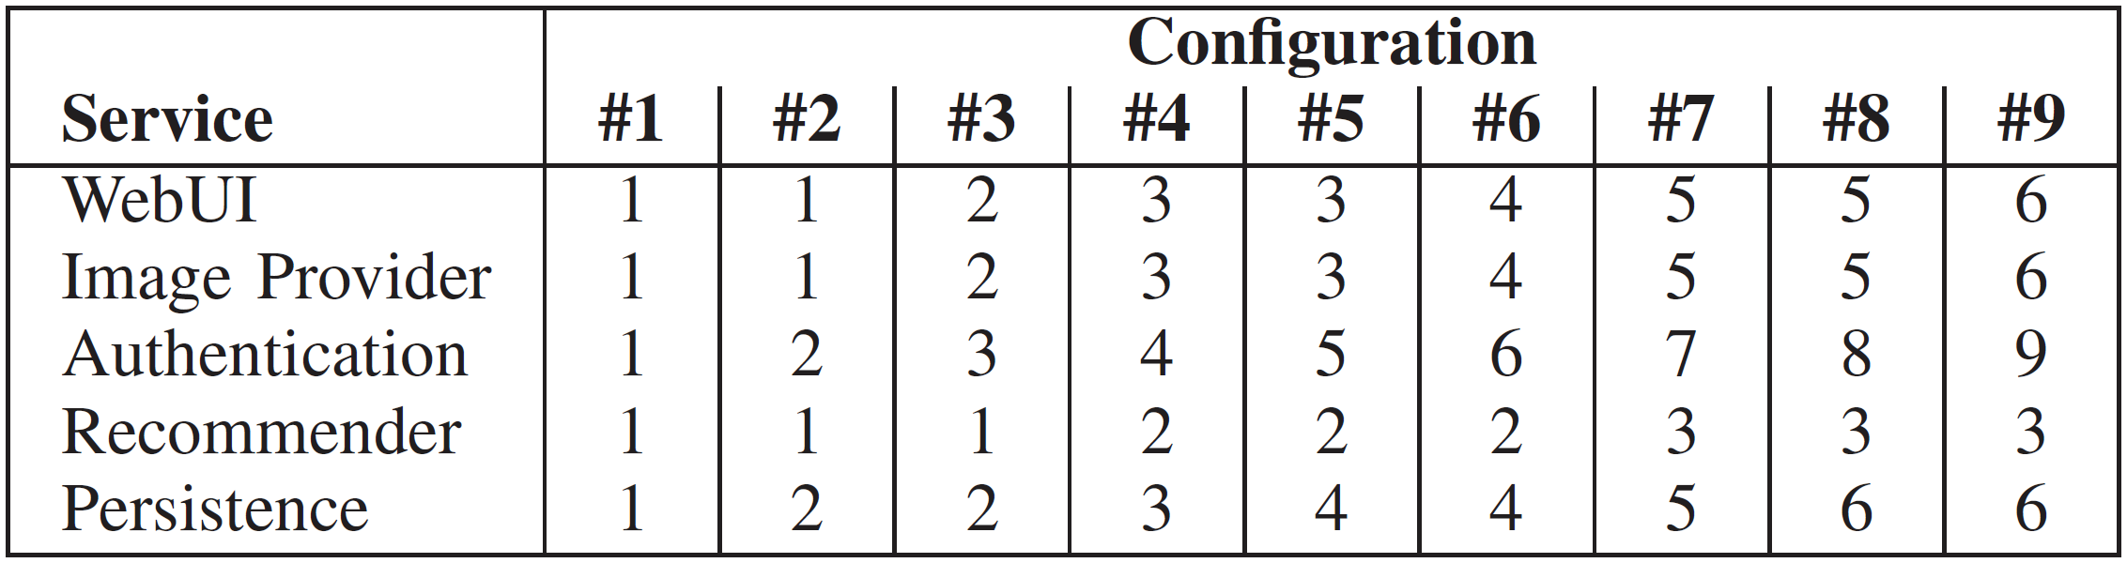
Auto-Scaling - Scenario
Reactive Auto-Scaling Scenario
Challenge: Scale in an elastic manner so that # services matches demand
Additional Challenge: Which service to scale?
Approach:
  Create heterogeneous configuration order
  Put TeaStore under varying load
  Decide scale-up / scale-down using research auto-scaler REACT [7]
Introduction TeaStore Use-Cases Conclusion

Slide 14
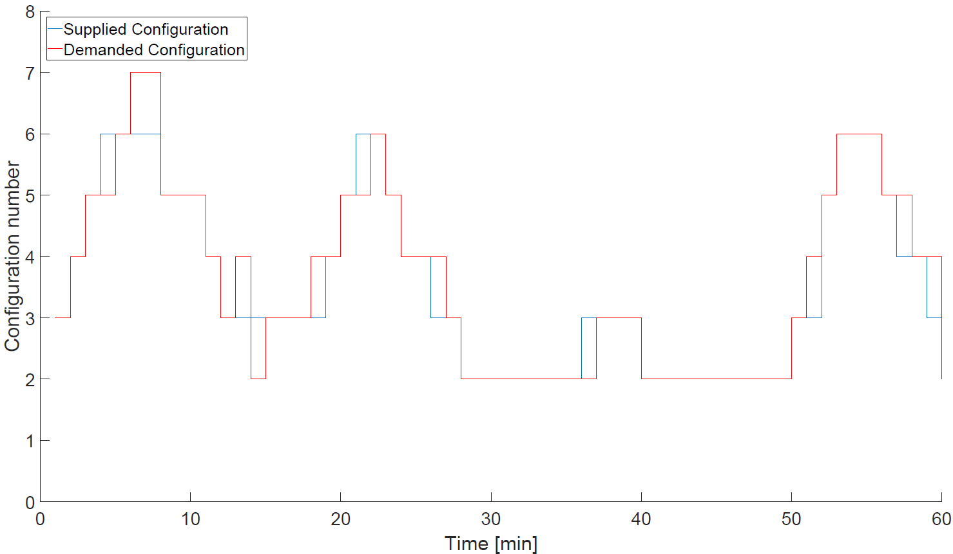
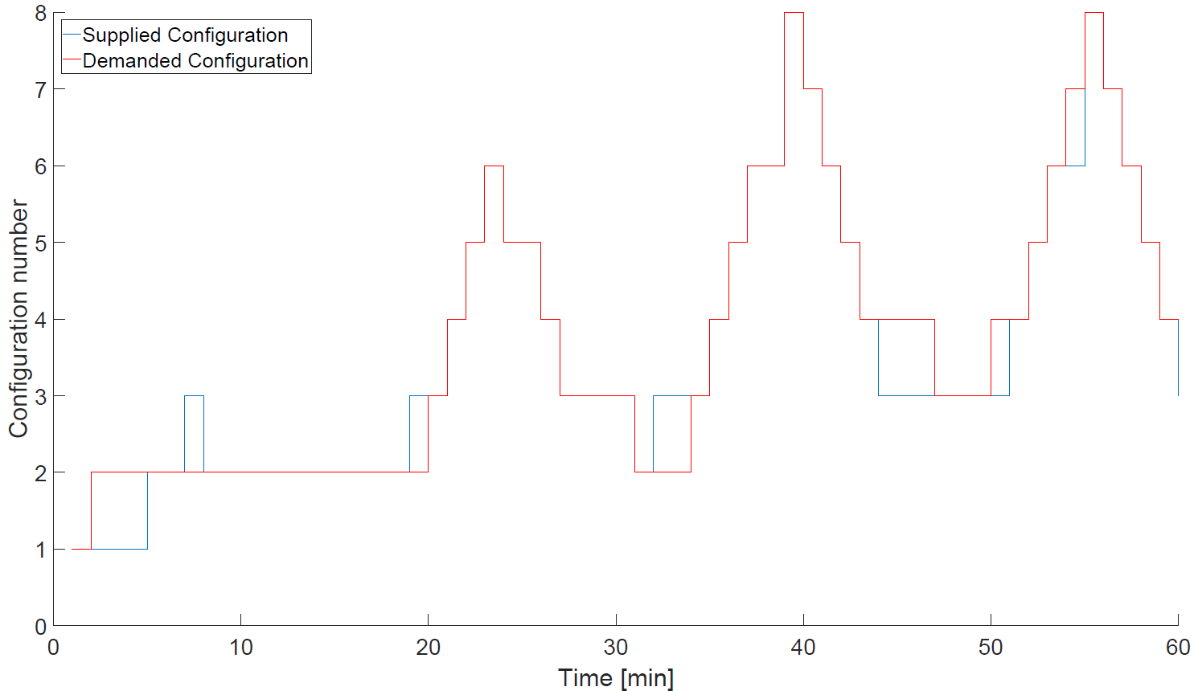
Auto-Scaling - Results
BibSonomy Trace
FIFA Trace
  Under- and overprovisioning-timeshare <= 15%
  TeaStore can be used for auto-scaler evaluation
  Open challenge: Which service to scale next?
Introduction TeaStore Use-Cases Conclusion
Notes:
One hour experiments
30 service instances max

Slide 15
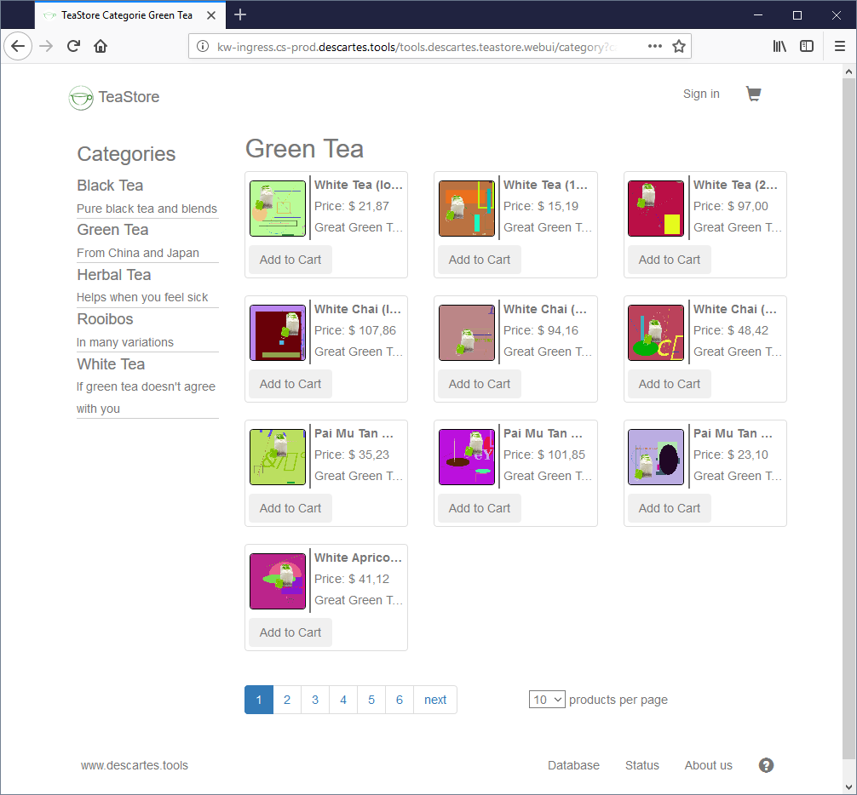
Performance Model - Scenario
Question: How does utilization change with the default # products per page ?
Approach:
  Create and calibrate performance model with default distribution
  Predict performance for
    Different products per page distribution
    Different service placement
Introduction TeaStore Use-Cases Conclusion

Slide 16
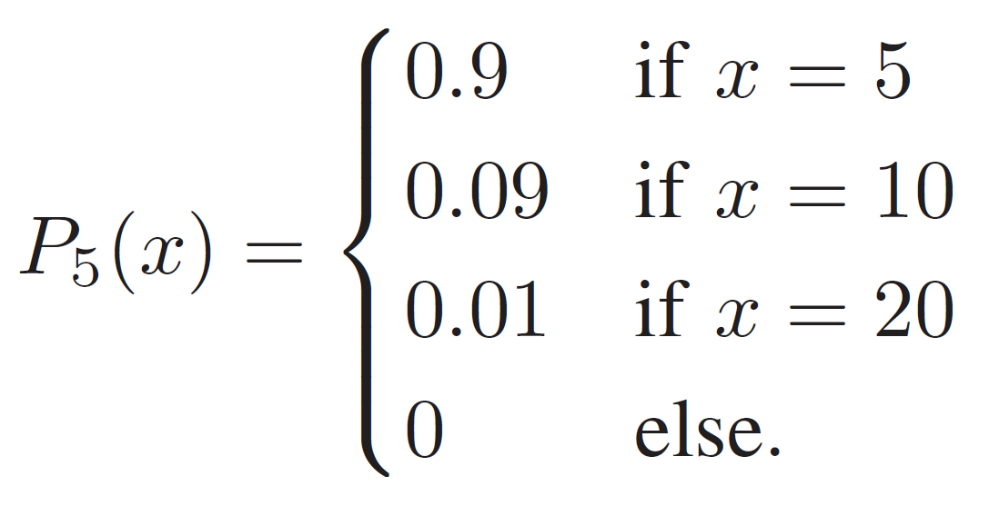
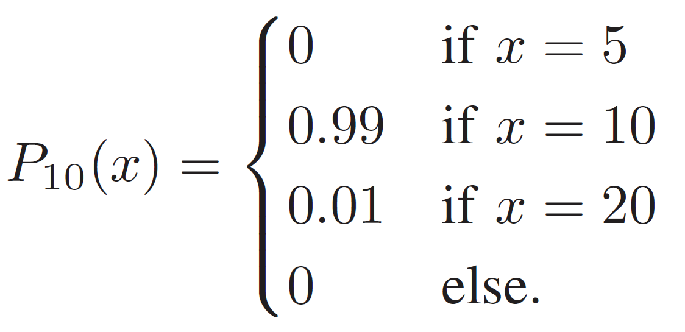
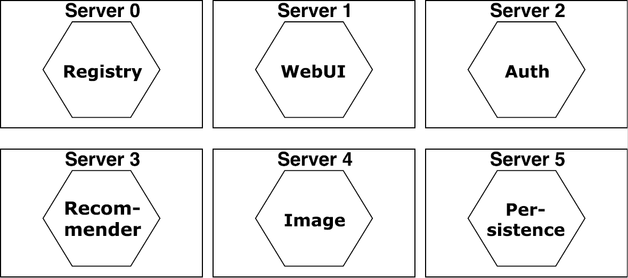
Performance Model - Models
Products per Page Distribution
Deployment
Calibration
To Predict
Calibration
To Predict
Introduction TeaStore Use-Cases Conclusion

Slide 17
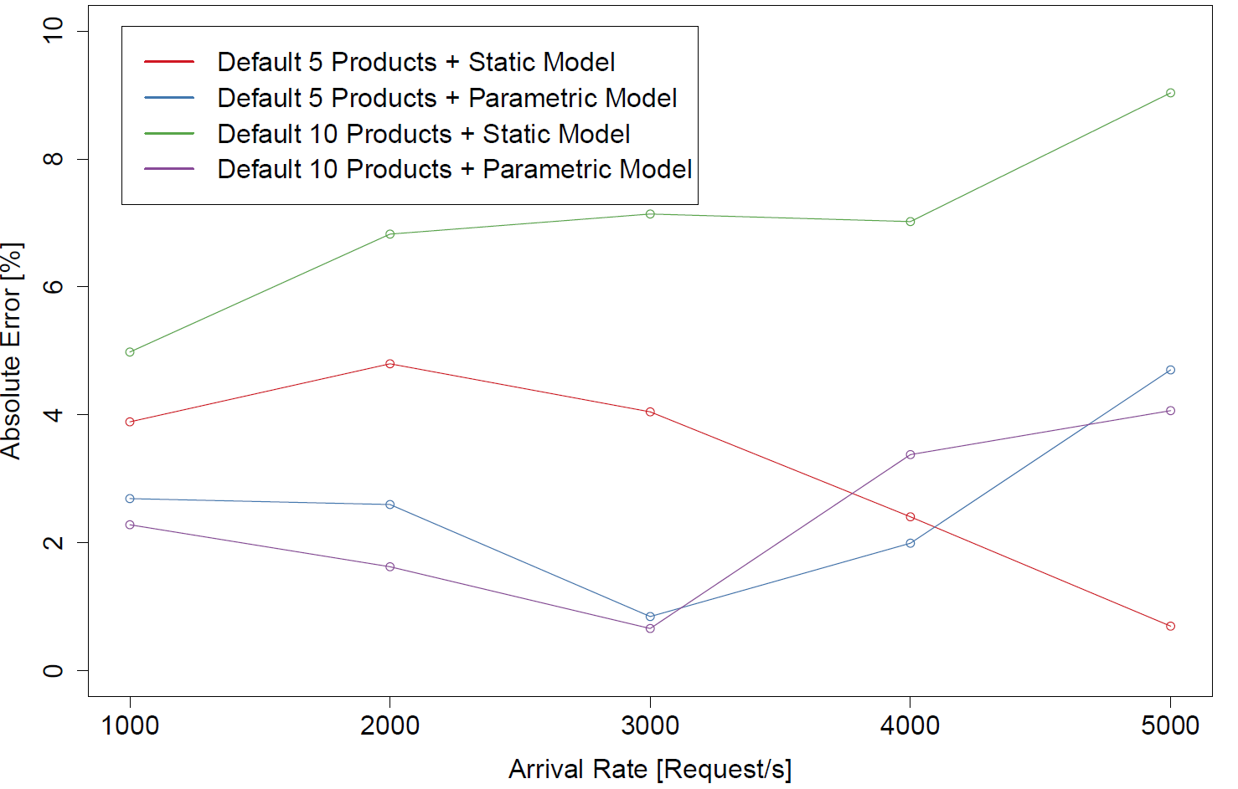
Performance Model - Results
Results with and without considering the parametric dependency
using Service Demand Law-based model
Introduction TeaStore Use-Cases Conclusion

Slide 18

Energy Efficiency - Scenario
Energy efficiency of placements
Goal: Show that power consumption, energy efficiency, and performance scale differently
  Different optima for service placements
Approach:
  Distribute TeaStore on heterogeneous servers
  Put TeaStore under stress-test load intensity
  Measure TeaStore performance and server wall power
Introduction TeaStore Use-Cases Conclusion

Slide 19
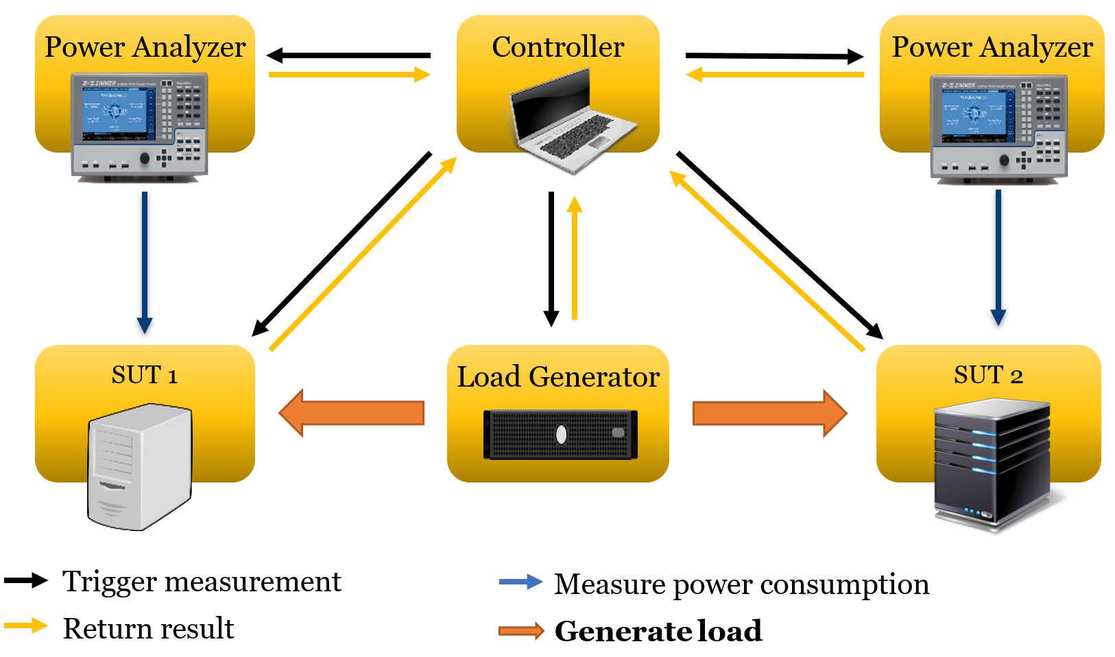
Energy Efficiency - Measurement
Measurements in heterogeneous setting
SUT 1:
  16 core Haswell
  32 GB RAM
SUT 2 (Heterogeneous):
  8 core Skylake
  16 GB RAM
Metrics:
  Throughput
  Power
  Energy Efficiency
    Throughput / Power
Introduction TeaStore Use-Cases Conclusion

Slide 20


Energy Efficiency – Optima for Heterogeneous Placement
Placement Candidate 1
Placement Candidate 2
16 cores
8 cores
16 cores
8 cores
WebUI
WebUI
WebUI
WebUI
Auth
Auth
Auth
Auth
Rec-omm.
Rec-omm.
Img
Img
Img
Img
Per-sist.
Per-sist.
Per-sist.
Per-sist.
Max | 1011.9 Tr/s
Max | 179.6 W
Geo | 4.4 Tr/J
Max | 1067.7 Tr/s
Max | 187.0 W
Geo | 4.3 Tr/J
Introduction TeaStore Use-Cases Conclusion

Slide 21

TeaStore - Conclusions
Teastore can be used for
  Performance modeling evaluation
  Auto-Scaler evaluation
  Placement and energy-efficiency evaluation
  …
Micro-service reference application
  Five Services + Registry
  Kieker monitoring
  Load Generators and Load Profiles
  Kubernetes support
Under Review by SPEC RG
https://github.com/DescartesResearch/TeaStore
Introduction TeaStore Use-Cases Conclusion

Slide 22








Thank You!
From the TeaStore Dev Team
https://github.com/DescartesResearch/TeaStore
HTTP Load Generator
https://github.com/joakimkistowski/HTTP-Load-Generator
LIMBO Load Intensity Modeling Tool
http://descartes.tools/limbo
Kieker Application Monitoring
http://kieker-monitoring.net
All tools available at:
http://descartes.tools/
Introduction TeaStore Use-Cases Conclusion
Notes:
Kieker not available on descartes.tools

Slide 23
References
[1] RUBiS User’s Manual, May 2008.
[2] Standard Performance Evaluation Corporation (SPEC). SPEC jEnterprise 2010 Design Document. https://www.spec.org/jEnterprise2010/docs/DesignDocumentation.html, May 2010, Accessed: 16.10.2017.
[3] Weaveworks Inc. Sock Shop: A Microservice Demo Application. https://github.com/microservices-demo/microservices-demo, 2017, Accessed: 19.10.2017.
[4] A. van Hoorn, J. Waller, and W. Hasselbring. Kieker: A framework for application performance monitoring and dynamic software analysis. In Proceedings of the 3rd joint ACM/SPEC International Conference on Performance Engineering (ICPE 2012), April 2012.
[5] J. von Kistowski, M. Deffner, and S. Kounev. Run-time Prediction of Power Consumption for Component Deployments. In Proceedings of the 15th IEEE International Conference on Autonomic Computing (ICAC 2018), Trento, Italy, September 2018.
[6] J. von Kistowski, N. Herbst, S. Kounev, H. Groenda, C. Stier, and S. Lehrig. Modeling and Extracting Load Intensity Profiles. ACM Transactions on Autonomous and Adaptive Systems (TAAS), 11(4):23:1 - 23:28, January 2017.
[7] T. C. Chieu, A. Mohindra, A. A. Karve, and A. Segal. Dynamic scaling of web applications in a virtualized cloud computing environment. In International Conference on E-Business Engineering, 2009.
[8] N. R. Herbst, S. Kounev, and R. Reussner. Elasticity in Cloud Computing: What it is, and What it is Not. In Proceedings of the 10th International Conference on Autonomic Computing (ICAC 2013), San Jose, CA, June 2013.

Slide 24
Additional Performance Properties
Two types of caches
  Black-box JPA persistence cache
  White-box image provider cache
Different and mixed load types
  CPU
  I/O
  Memory
Internal state
  Database size influences resource demands
Load independent tasks
  Periodic recommender retraining (optional)
Startup behavior
  Auth and WebUI start “instantly”
  Recommender needs training on startup
  Image Provider creates images on startup
Configuration options
  Recommender algorithms
  Recommender retraining interval
  Image Provider cache implementations
  Database size
Introduction TeaStore Use-Cases Conclusion

Slide 25
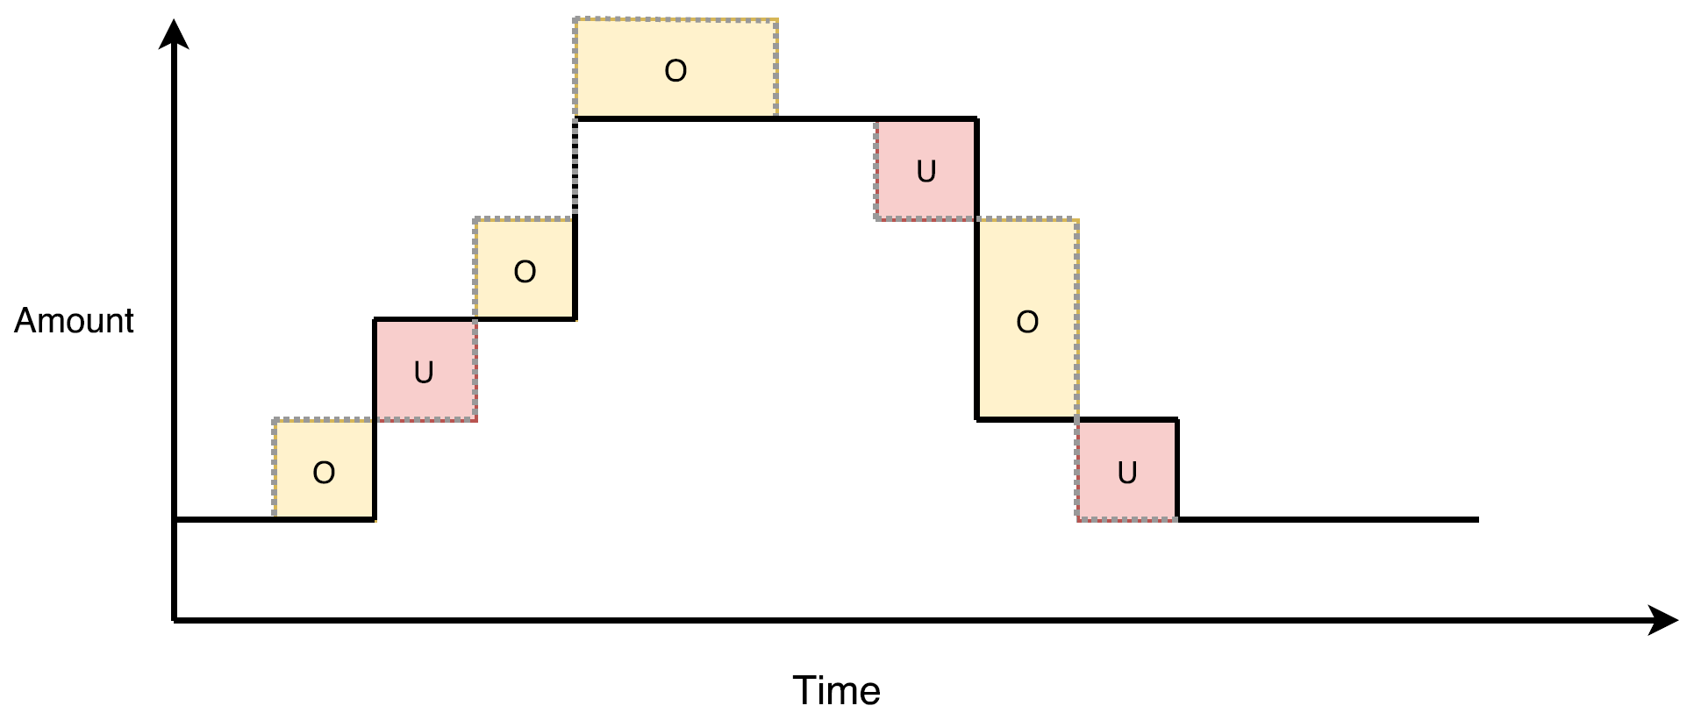
Auto-Scaling – Elasticity Metrics
“Elasticity is the degree to which a system is able to adapt to workload changes by provisioning and deprovisioning resources in an autonomic manner, such that at each point in time the available resources match the current demand as closely as possible.“ [8]
Elasticity metrics
  Accuracy: average proportion
  of resources that the system
  has over-/under-provisioned
  Time Share: average time in
  which the system is an
  over-/under-provisioned state
Introduction TeaStore Use-Cases Conclusion

