Slide 1
Please Obey My Plan: How To Optimise Decentralised Self-Adaptive Systems
Veronika Lesch, Christian Krupitzer University of Würzburg, Germany
Sven Tomforde University of Kassel, Germany
SelPhyS 2019 Munich, 15th April 2019

Slide 2
Platooning Coordination
Decentral Planning
Central Planning
M
A
P
E
1
1
M
A
P
E
M
A
P
E
M
A
P
E
M
A
P
E
Notes:
Domain: Autonomous self-adaptive systems
Running Example: Platooning Coordination
Platooning: driving in convoys of automated vehicles with inter vehicle distances of only a few meters
Decentralised planning → local optimal → advantage of scalability, cost of potentially contradicting adaptations
Central planning → global optimal → overcome the issue of conflicts but higher processing times, central bottleneck, single point of failure
Problem: SAS may disobey plans from central coordination → system requires to guarantee execution→ incentives, adaptation freedom
AIM: hybrid approach → Trade off between central and decentral planning with global and local optimisation with objectives: reaction time, costs, coordination effort

Slide 3
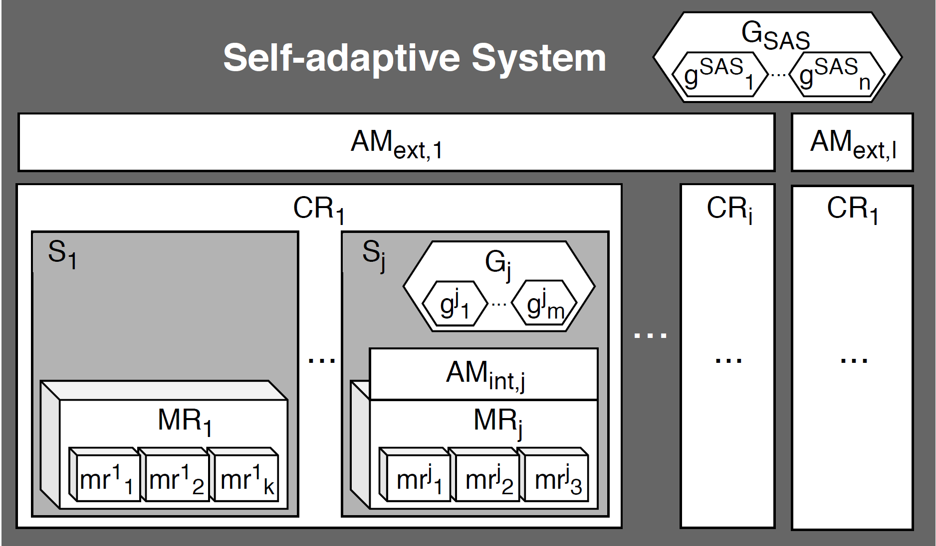
System Model
Self-adaptive System: Traffic
Coordinated Ressource: Platoon
Subsystem: Vehicle

Slide 4
Objectives
Development of a centralised optimisation mechanism that balances conflicting goals and constraints
Improving robustness of solution by providing degrees of freedom, alternative solutions and incentives for execution-enforcement
Investigation of a subsequently distributed adaptation execution algorithm that controls the application of the plan within a set of autonomous entities by making use of the provided freedom
Analyse the relations of autonomic vs. heteronomic decisions of entities on the optimisation procedure
Design and implementation of a support process for developers

Slide 5
Platooning Coordination Use Case
Platooning: Self-driving vehicles in coordinated convoys
Self-driving vehicles act autonomously
Individual preferences of the driver
Environment with specified interaction rules
Decentralised planning
Collect information about platoons
Requires vehicle to vehicle communication
Locally optimised
Results in conflicts (position in platoon)
Centralised planning
Intermediary system collects information about vehicles and platoons
Balances interests of vehicles, platoons, global traffic
No guarantee that instructions are executed by autonomous vehicles

Slide 6
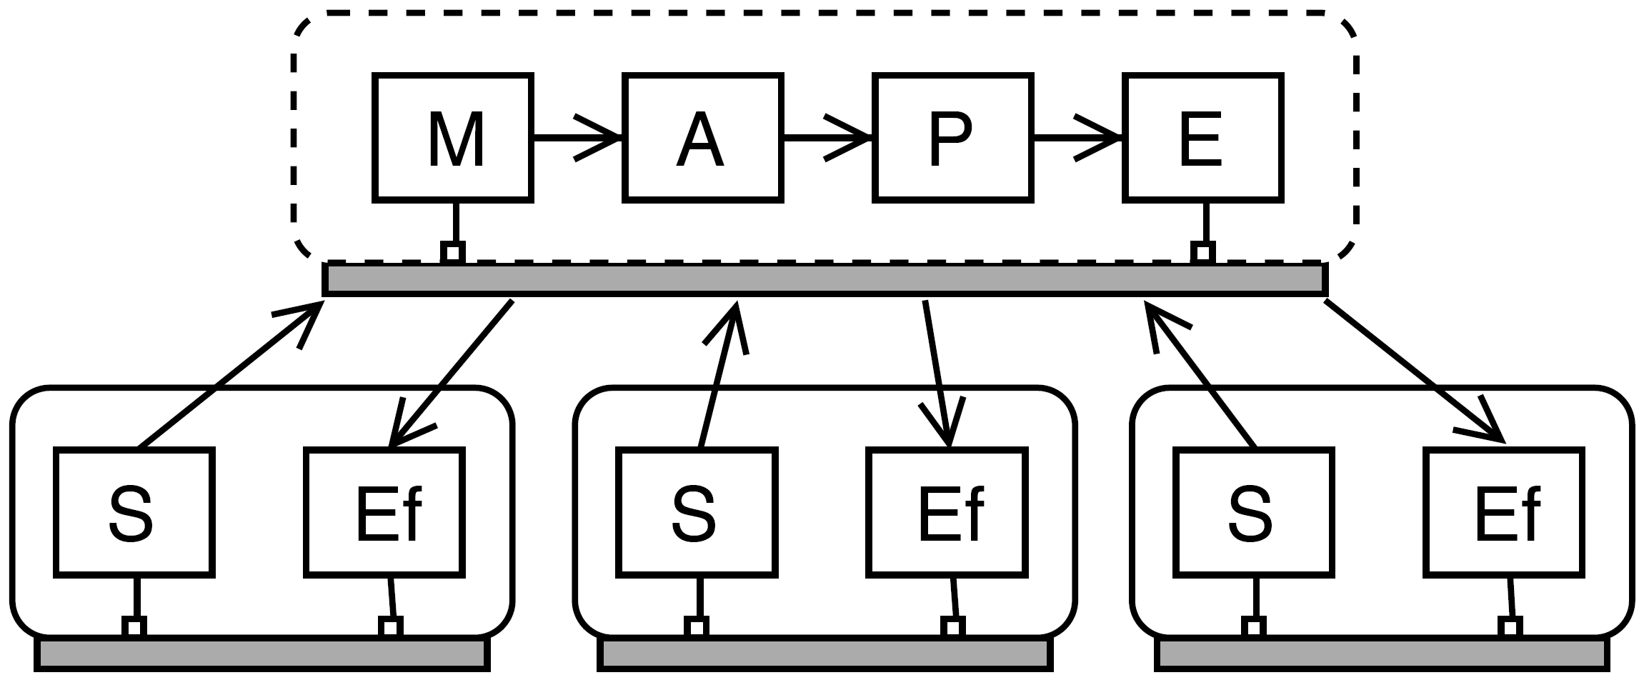
Challenges – C 1
Central Plan.
Decentral Plan.
Multi-objective central optimisation with constraints
Goal: Runtime-applicable heuristic, rather “good enough” solutions than “optimal” ones.
Choice of optimiser
Time vs optimality
Incorporation of constraints
Notes:
Which are suitable basic optimisation techniques?
How to balance the trade-off between fast response and optimal solutions?
How to incorporate constraints (e.g. given by characteristics and preferences of entities)?

Slide 7
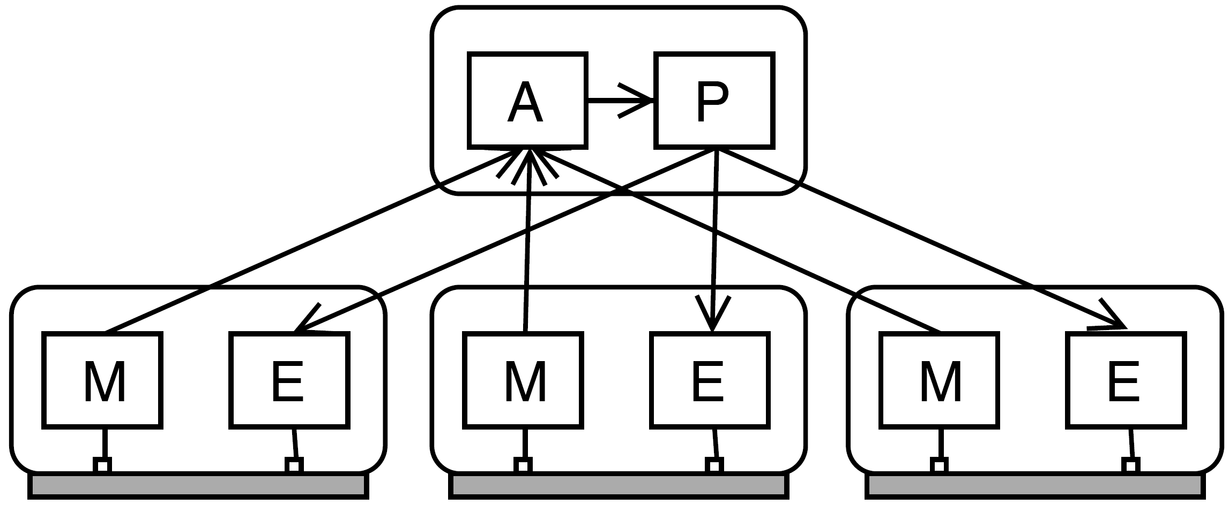
Challenges – C 2
Central Plan.
Decentral Plan.
Multi-objective central optimisation with adaptation freedom
Goal: Provide solutions with alternative realisations and decision freedom for the adaptation execution.
Definition of ranges of allowed configurations
Coordination of execution
Introduction of feedback loop
Notes:
How to define ranges of allowed configurations for decision freedom for the adaptation execution?
How to ensure compliance of autonomous adaptation execution?
How to generate feedback from the adaptation enforcement that guides the search within the planning process?

Slide 8
Challenges – D 1
Central Plan.
Decentral Plan.
Decentralised non-coordinated optimisation
Goal: Negotiate solutions in open collections of autonomous entities
Prevention of unstable behaviour and oscillations
Handle information sub-sets
Incorporation of multiple goals
Notes:
BU2: Koordination nur innerhalb der Execution Phase der Systeme
How to avoid continuous re-optimisation if composition changes?
How to incorporate multiple goals in the negotiation process?
How to act on local information sub-sets?

Slide 9
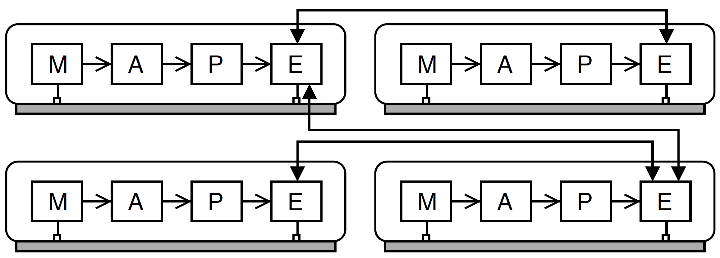
Challenges – D 2
Central Plan.
Decentral Plan.
Decentralised coordinated multiobjective optimisation
Goal: Negotiate solutions in open collections of autonomous entities
Identification of important aspects
Integration of local constraints
Incentivation
Notes:
BU2: Koordination nur innerhalb der Execution Phase der Systeme
Which aspects need to be taken into account?
How to integrate local constraints while obeying coordination results?
How to include an incentivation for coordination?

Slide 10
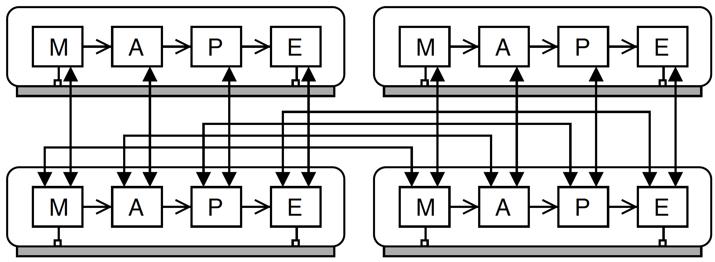
Challenges - HY
Central Plan.
Decentral Plan.
Distributed global multi-objective optimisation
Goal: Coupling of global planning and local execution
Effective coordination of autonomous agents
Execution enforcement
Notes:
Coordination in Planning Phase not in Execution
How to effectively coordinate a decentralised planning process within autonomous agents?
How to enforce plans if collections change continuously?

Slide 11
Wrap-Up
Two common approaches for optimising self-adaptive systems
Decentral planning → Local optimal but conflicting decisions may occur
Central planning → Global optimal but single point of failure, systems may refuse execution of plan
Hybrid Approach is desired
Combines advantages
Reduces drawbacks of both extremes
Challenges to achieve a hybrid approach are identified
Running example platooning coordination for all challenges

Slide 12
Thank you for your attention
SelPhyS 2019
Munich, 15th April 2019

