Slide 1


Chameleon: Design and
Evaluation of a Proactive,
Application-Aware Elasticity
Mechanism
André Bauer, Simon Spinner, Nikolas Herbst, Samuel Kounev
Chair of Software Engineering
University of Würzburg
http://se.informatik.uni-wuerzburg.de/
Symposium on Software Performance
Kiel, November 09, 2016
http://descartes.tools/chameleon

Slide 2

Motivation
Cloud computing is a paradigm which
faces the increasing scale and complexity
of modern internet services
To guarantee a reliable service, most application run with a fixed amount of resources
  High energy consumption, if the system is not fully utilized
  Bad performance, if unexpected peaks appear
High quality auto-scalers are required,
which reconfigure the system regarding
its load
Introduction
Approach
Evaluation
Conclusion

Slide 3
State of the Art
Auto-scalers can be classified into 5 groups [Lorido-Botran14]
Prominent examples of each group:
Mechanism are either generic or application-specific
Threshold-based Rules
Queueing Theory
Control Theory
[Maurer11]
[Urgaonkar08]
(Hist)
[Adhikari12]
(Adapt)
Reinforcement Learning
Time Series Analysis
Chameleon
[Rao09]
[Iqbal11]
(Reg)
Delimitation: Chameleon is both generic and application-aware
Introduction
Approach
Evaluation
Conclusion

Slide 4
In a Nutshell…
Existing auto-scalers are either application-specific or generic.
Bad performance can be translated into loss of money or customers
Controller combines time series analysis and query theory enriched with application knowledge
Expected: More accurate scaling decisions compared to other controllers or standard reactive
Taking forecasting, resource demand estimation and application model into account to increase the performance of the reconfiguration
Problem
Idea
Benefit
Action
Introduction
Approach
Evaluation
Conclusion

Slide 5


Data Flow of Chameleon
6: reconfigures cloud
5: determines resource
demands
Cloud
Chameleon
Controller
Resource Demand Estimation Component
- LibReDE -
Business Application
monitors cloud
3: send data
has
DML
model
saves the observed
data
1: requests
historical data
Forecast Component
- WCF -
4: forecasts
load
Performance Repository
DML Model
Time Series Storage
2: sends
data
http://descartes.tools/
Introduction
Approach
Evaluation
Conclusion

Slide 6
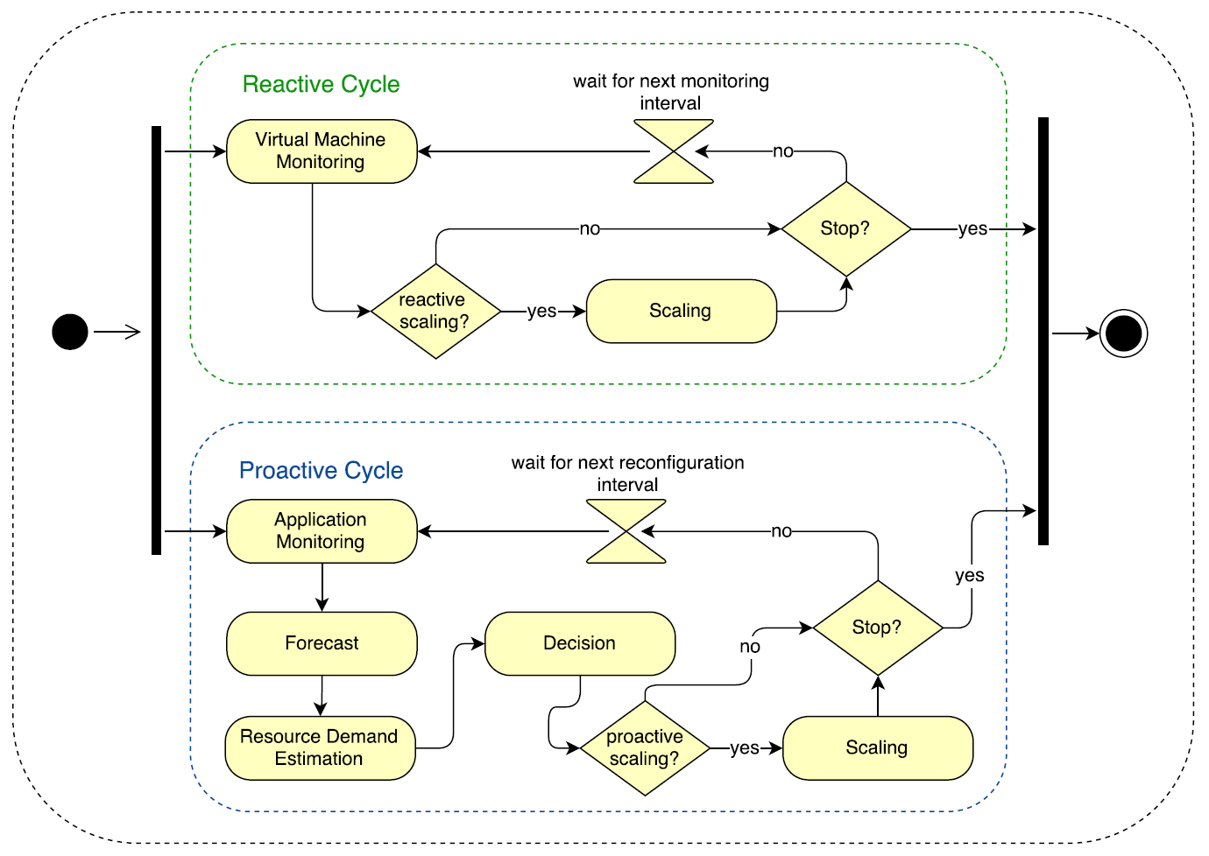
Activity diagram of Chameleon
Introduction
Approach
Evaluation
Conclusion

Slide 7

Assumptions & Evaluation Overview
Assumptions
  Availability of at least 4 days of historical data
  The SLO is the response time
  Chameleon is limited to scale CPUs
  A DML model is already provided
Chameleon is driven with two different scenarios
  CPU intensive scenario
  The business application SPECjEnterprise2010
Both scenarios are deployed in a private
CloudStack environment
Introduction
Approach
Evaluation
Conclusion

Slide 8
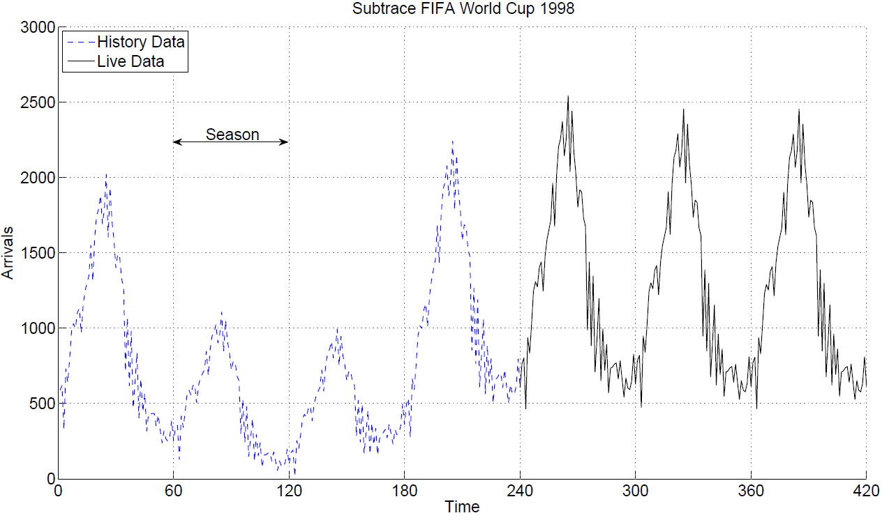
Workload
FIFA world cup 1998 is used for an authentic workload
  A sequence of 7 days were cropped out
  4 days as historical data for WCF
  3 days for the evaluation
Introduction
Approach
Evaluation
Conclusion

Slide 9


Benchmarking
Evaluation with Bungee experiment controller
  Perform each scenario with Chameleon
  Perform each scenario with other auto-scalers
    Hist [Urgaonkar08]
    Reg [Iqbal11]
    Adapt [Adhikari12]
    ConPaaS [Pierre12]
  Compare the results with benchmarking metrics
Benchmarking Metrics
  Elasticity metrics
  User metrics
    Number of SLO violations
    Average response time
    90th percentile of response time
Resource Demand
#Running
VMs
Load requests
Introduction
Approach
Evaluation
Conclusion

Slide 10
CPU Intensive Scenario
Workload is accelerated 8 times: 3 d → 9 h
  Between 40 and 200 request/second
  3.5 million requests
Setup contains up to 20 WildFly slaves, 1 Domain controller and 1 Citrix Netscaler (LB)
  2 cores @2.6GHz
  4 GB memory
Each slave is a http application
  Request parameter n, here 600
  LU decomposition of a random generated nxn matrix
SLO: 90% of responses < 5 seconds
Introduction
Approach
Evaluation
Conclusion

Slide 11
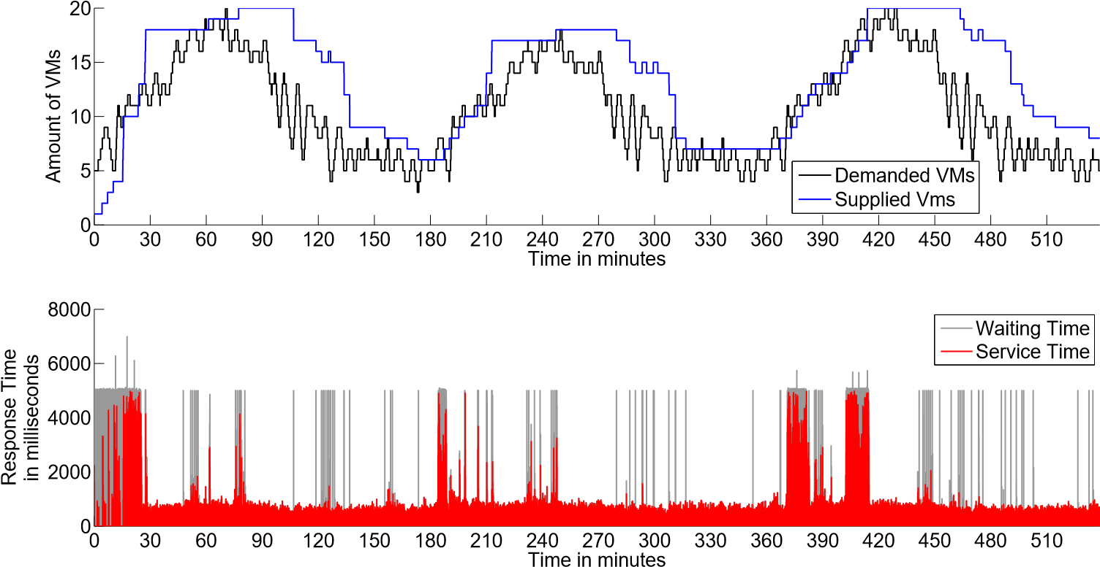
Evaluation Part I
Scaling Chameleon
Introduction
Approach
Evaluation
Conclusion

Slide 12
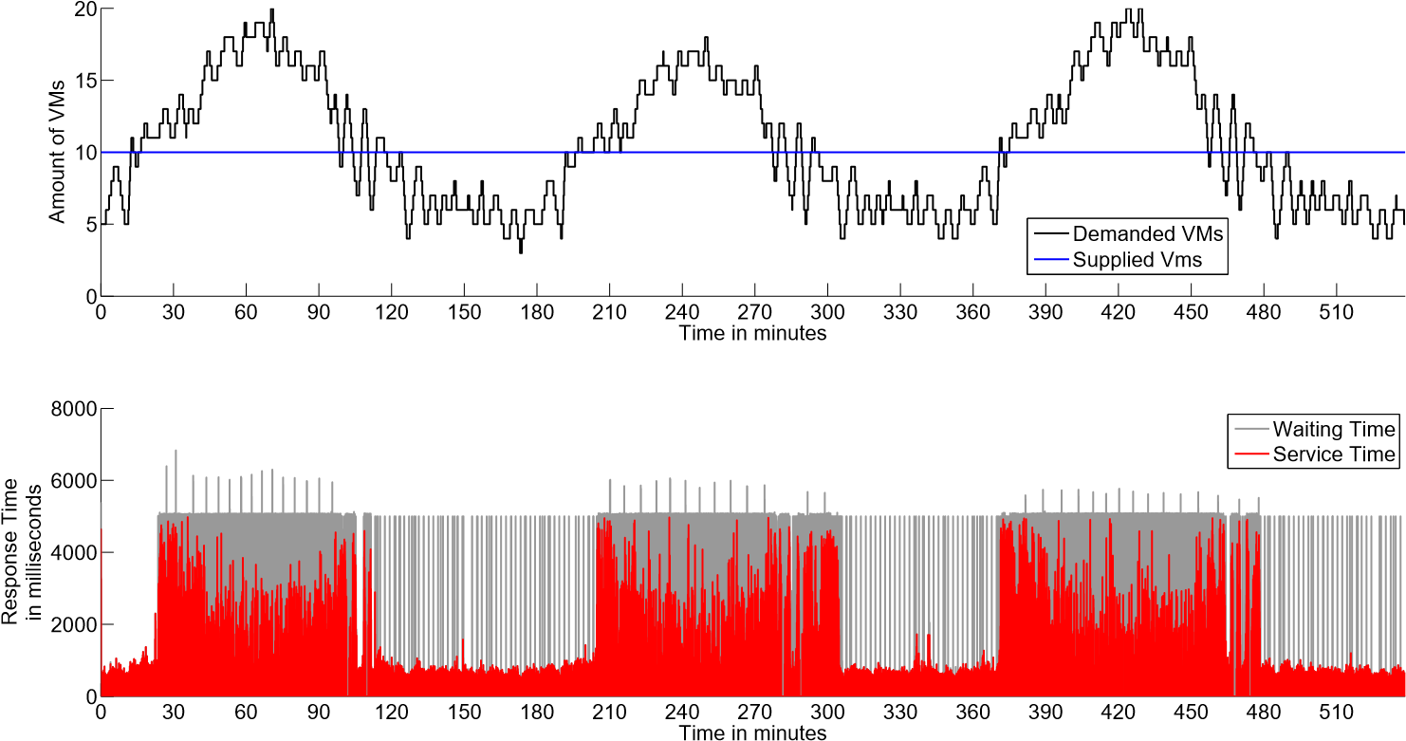
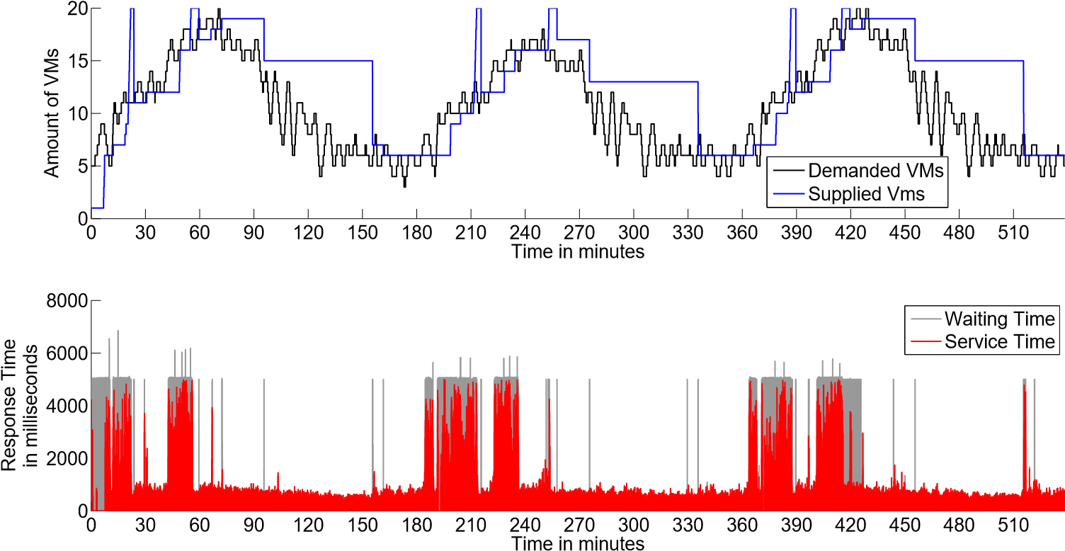
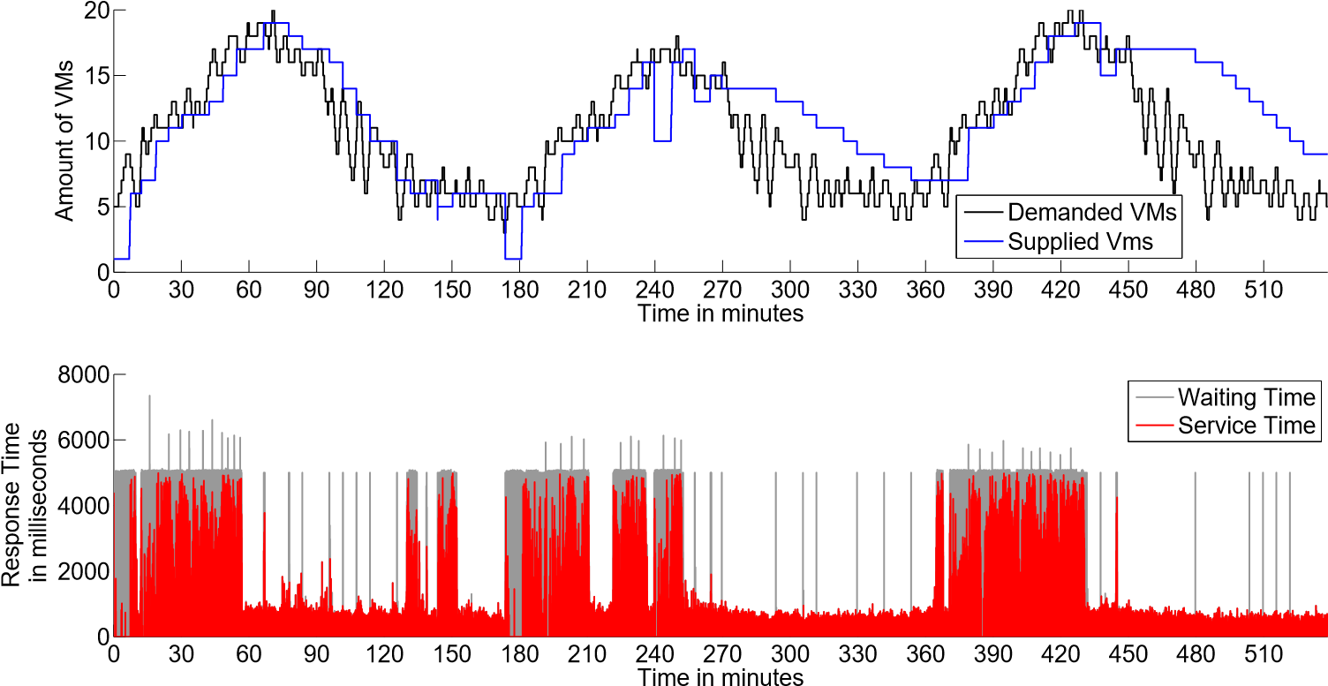
Evaluation Part II
No Auto-Scaling
Scaling Chameleon
Scaling Hist
Scaling Reg
Introduction
Approach
Evaluation
Conclusion

Slide 13
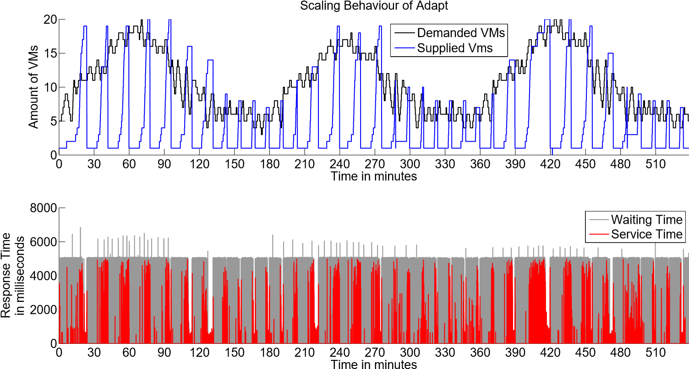
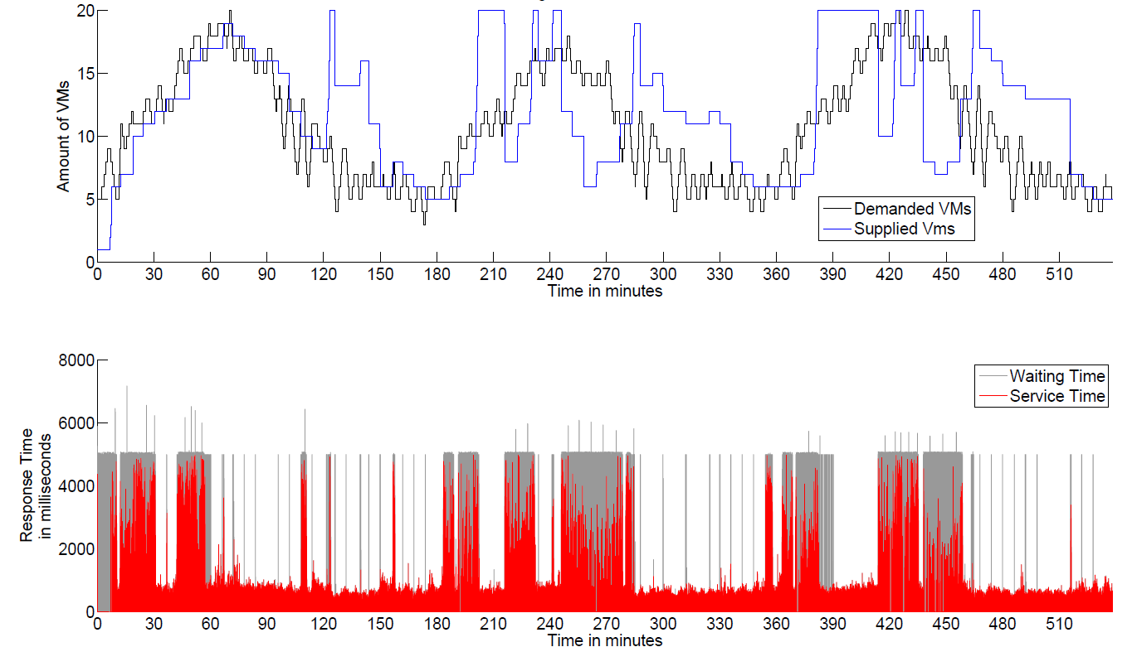
Evaluation Part III
Scaling Chameleon
Scaling Adapt
Scaling ConPaaS
Introduction
Approach
Evaluation
Conclusion

Slide 14
Metric Comparison
Metrics | No Scaler | Chameleon | Hist | Adapt | Reg | ConPaaS
accuracy_{o} | 0.282 | 0.350 | 0.387 | 0.079 | 0.289 | 0.387
accuracy_{u} | 0.147 | 0.030 | 0.055 | 0.613 | 0.078 | 0.105
timeshare_{o} | 0.453 | 0.755 | 0.608 | 0.181 | 0.52 | 0.535
timeshare_{u} | 0.491 | 0.129 | 0.285 | 0.788 | 0.371 | 0.355
jitter | -0.924 | -0.723 | -0.654 | -0.615 | -0.719 | -0.466
instability | 0.478 | 0.215 | 0.22 | 0.418 | 0.196 | 0.235
#Adaptions | 0 | 85 | 110 | 618 | 93 | 204
Avg. #VMs | 10 | 12.5 | 13.4 | 8.1 | 11.1 | 13.2
score_{NoScaler} | 1 | 1.330 | 1.151 | 0.896 | 1.177 | 1.143
Avg. response time | 1251 ms | 671 ms | 1267 ms | 4339 ms | 2018 ms | 2082 ms
P₉₀ response time | 5002 ms | 1051 ms | 5002 ms | 5002 ms | 5002 ms | 5002 ms
Violations | 18.07% | 7.50% | 19.24% | 82.75% | 32.25% | 35.98%
Chameleon achieves highest score and lowest SLO violations
Introduction
Approach
Evaluation
Conclusion

Slide 15
Metric Comparison
Metrics | No Scaler | Chameleon | Hist | Adapt | Reg | ConPaaS
accuracy_{o} | 0.960 | 0.350 | 0.387 | 0.079 | 0.289 | 0.387
accuracy_{u} | 0.002 | 0.03 | 0.055 | 0.613 | 0.078 | 0.105
timeshare_{o} | 0.921 | 0.755 | 0.608 | 0.181 | 0.52 | 0.535
timeshare_{u} | 0.033 | 0.129 | 0.285 | 0.788 | 0.371 | 0.355
jitter | -0.924 | -0.723 | -0.654 | -0.615 | -0.719 | -0.466
instability | 0.478 | 0.215 | 0.22 | 0.418 | 0.196 | 0.235
#Adaptions | 0 | 85 | 110 | 618 | 93 | 204
Avg. #VMs | 18 | 12.5 | 13.4 | 8.1 | 11.1 | 13.2
score_{NoScaler} | 1 | 1.364 | 1.180 | 0.918 | 1.207 | 1.172
Avg. response time | 383 ms | 671 ms | 1267 ms | 4339 ms | 2018 ms | 2082 ms
P₉₀ response time | 367 ms | 1051 ms | 5002 ms | 5002 ms | 5002 ms | 5002 ms
Violations | 2.24% | 7.50% | 19.24% | 82.75% | 32.25% | 35.98%
Chameleon achieves highest score and lowest SLO violations
Introduction
Approach
Evaluation
Conclusion

Slide 16
Future Work
For Chameleon:
  Add vertical scaling and migration
  Improve precision by dynamic method selection
  Integration of a DML extractor and solver
  Taking billing of reconfigurations into account
For evaluation:
  Distributed JMeter usage
  Calibration search vs. bottleneck shadowing
  Retaking the experiments in a public cloud
  Multitier scaling of SPECjEnterprise2010
  Scale another multi-tier application (e.g., RuBiS)
  Evaluate energy savings by auto-scaling
Introduction
Approach
Evaluation
Conclusion

Slide 17
Conclusion
Existing auto-scalers are either application-specific or generic.
Bad performance can be translated into loss of money or customers
Chameleon combines time series analysis and query theory enriched with application knowledge
Chameleon achieves the best score in the CPU intensive scenario compared with 4 existing auto-scaler
Release Chameleon as open source, …
Problem
Idea
Results
Ongoing Work
Introduction
Approach
Evaluation
Conclusion

Slide 18
Thank you for your attention
andre.bauer@uni-wuerzburg.de
http://descartes.tools/chameleon
http://se.informatik.uni-wuerzburg.de

Slide 19
Literature
[Adhikari12] R. Adhikari and R. Agrawal, “An Introductory Study on Time Series Modeling and Forecasting,” arXiv preprint arXiv:1302.6613, 2013.
[Iqbal11] W. Iqbal, M. N. Dailey, D. Carrera, and P. Janecek, “Adaptive Resource Provisioning for Read Intensive Multi-tier Applications in the Cloud,” Future Generation Computer Systems, vol. 27, no. 6, pp. 871-879, 2011.
[Lorido-Botran14] T. Lorido-Botran, J. Miguel-Alonso, and J. A. Lozano, “A Review of Autoscaling Techniques for Elastic Applications in Cloud Environments,” Journal of Grid Computing, vol. 12, no. 4, pp. 559-592, 2014.
[Maurer11] M. Maurer, I. Brandic, and R. Sakellariou, “Enacting Slas in Clouds Using Rules,“ in Euro-Par 2011 Parallel Processing. Springer, 2011, pp. 455-466.
[Rao09] J. Rao, X. Bu, C.-Z. Xu, L. Wang, and G. Yin, “VCONF: a Reinforcement Learning Approach to Virtual Machines Auto-conguration,” in Proceedings of the 6th international conference on Autonomic computing. ACM, 2009,pp. 137-146.
[Urgaonkar08] B. Urgaonkar, P. Shenoy, A. Chandra, P. Goyal, and T. Wood, “Agile Dynamic Provisioning of Multi-tier Internet Applications,“ ACM Transactions on Autonomous and Adaptive Systems (TAAS), vol. 3, no. 1, p. 1, 2008.
[Pierre12] Pierre, Guillaume, and Corina Stratan. "ConPaaS: a platform for hosting elastic cloud applications." IEEE Internet Computing 16.5 (2012): 88-92.

Slide 20
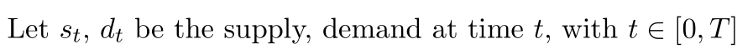
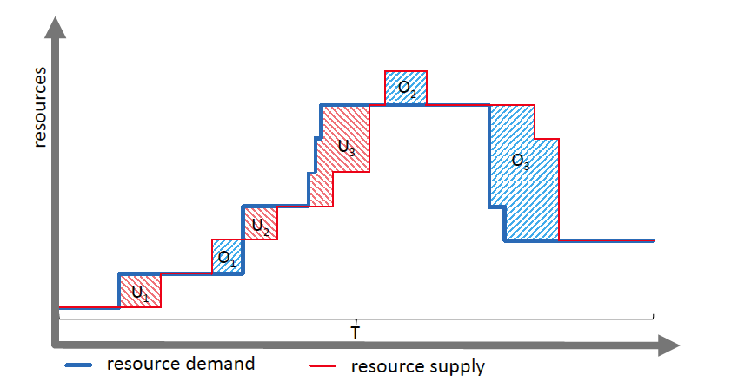
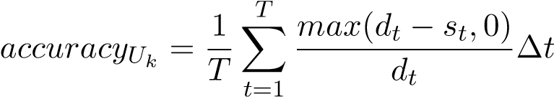
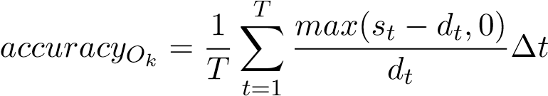
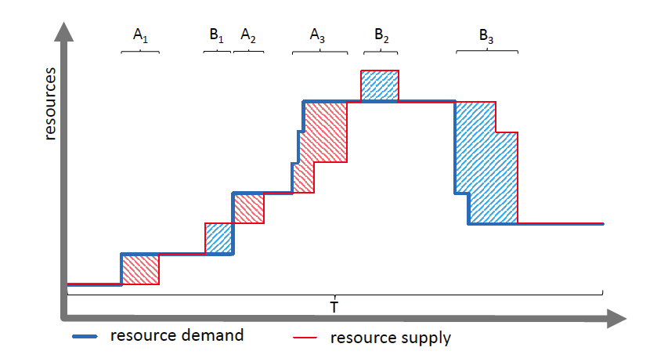
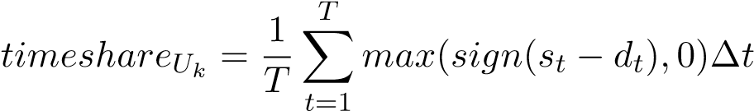
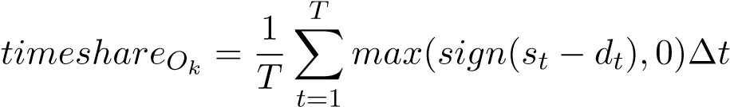
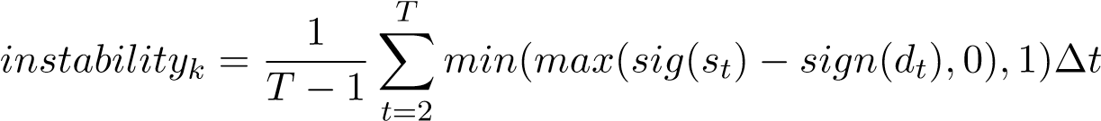
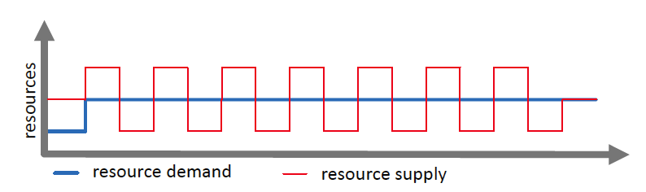
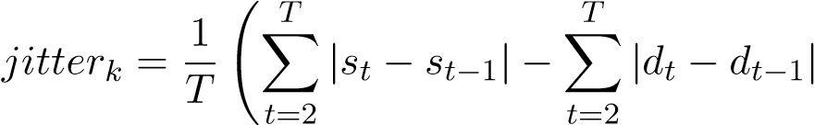
Elasticity Metrics

Slide 21
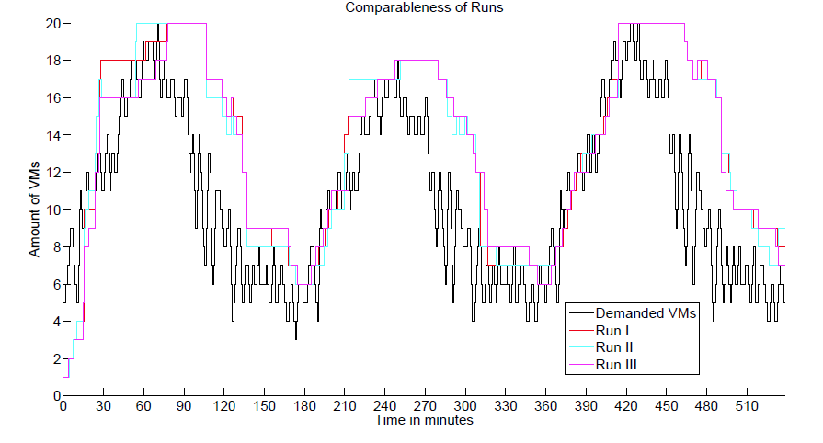
Reprodicibility
Reproducibility of the scaling behaviour
  3 runs with the same setting
  Elasticity score has a standard variation of 0.017

Slide 22
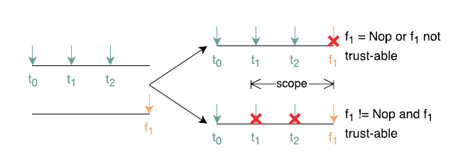
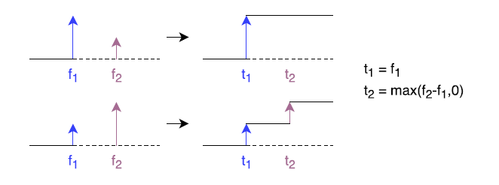
Logic I
Reactive scaling events vs. proactive scaling events
Chameleon plans reconfiguration steps in advance

Slide 23
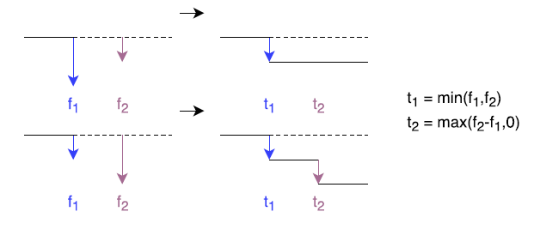
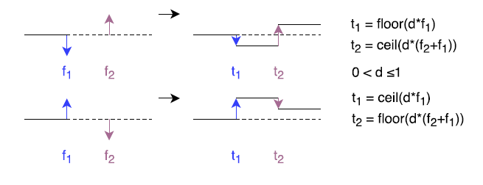
Logic II

Slide 24
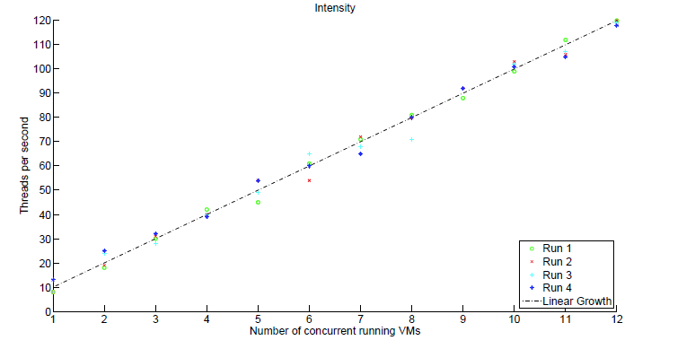
Resource Demand
Resource demand for Chameleon is determined via LibReDE
Resource demand for the existing auto-scalers is determined via the server speed

Slide 25
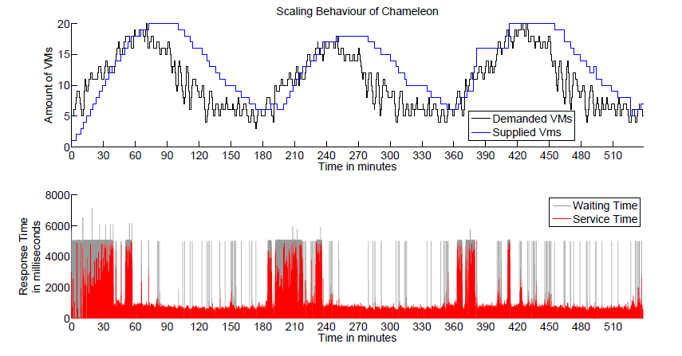
Without Historical knowledge
Chameleon without historical data
  Until minute 390: reactive scaling
  Afterwards proactive scaling

Slide 26
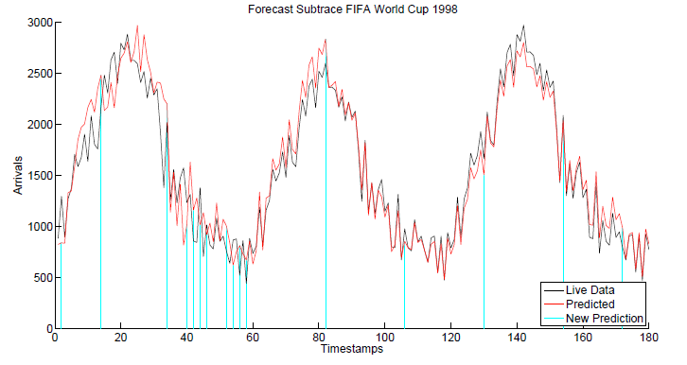
Forecasting
Modified WCF forecast strategy:
  Forecasts on demand
  Forecast model contains the next 24 predictions
  If MAPE > tolerance then build new forecast model

Slide 27
SPECjEnterprise2010
Setup contains 8 different tiers (= WildFly slaves), 1 Domain controller and 1 Citrix Netscaler (LB)
Problems with benchmarking
  Very small response time (about 10 ms)
  High load generation burden
  Difficult calibration (reproducibility, hidden bottlenecks,…)
SLO: 90% responses < 100 milliseconds
Only user metrics can be determined
  Number of SLO violations
  Average & median response time
  90th percentile of response time

Slide 28
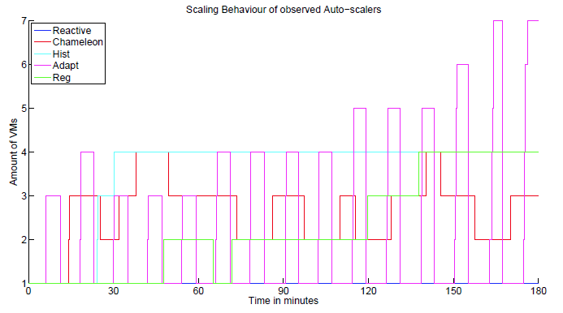
Metric Comparison
Metrics | Reactive | Chameleon | Hist | Adapt | Reg
Avg. response time | 669 ms | 476 ms | 404 ms | 592 ms | 500 ms
P₅₀ response time | 9 ms | 9 ms | 7 ms | 12 ms | 10 ms
P₉₀ response time | 2005 ms | 1876 ms | 1754 ms | 1899 ms | 1915 ms
Violations | 33,02 % | 27,19 % | 26,57 % | 27,32 % | 30,16 %
Chameleon achieves the second best user metrics

